Slide 1
GUI AI Learning Platform Design
TSDV
2021 年 02月 18 日

Slide 2



Main window
AI Learning Platform
Transfer Learning
Genneration Management

Slide 3
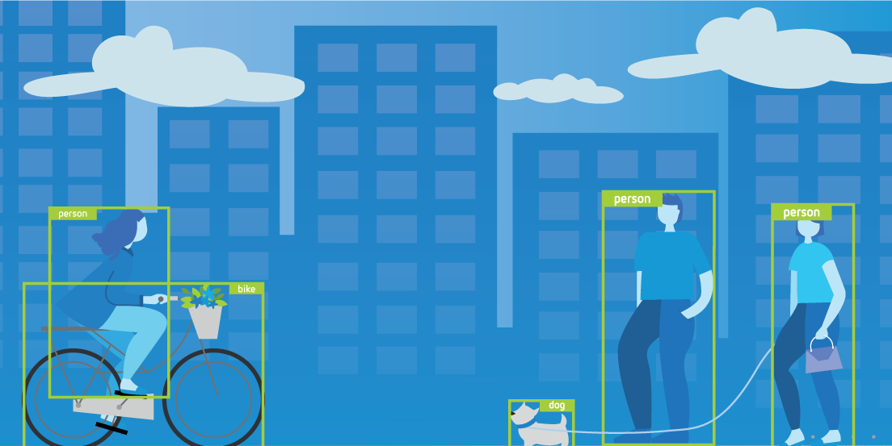
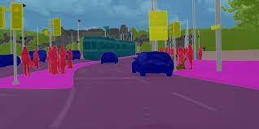

Transfer Learning window
Object-Detection Segmentation
Object Detection
Segmentation
Object detection combines classification and localization to determine what objects are in the image or video and specify where they are in the image. It applies classification to distinct objects and uses bounding boxes.
Segmentation identifies parts of the image and understanding what object they belong to. Segmentation lays the basis for performing object detection and classification.

Slide 4
Transfer Learning window
Object-Detection Segmentation
Train
Evaluate
Interference
Prune
Object Detection
Segmentation
Object detection combines classification and localization to determine what objects are in the image or video and specify where they are in the image. It applies classification to distinct objects and uses bounding boxes.
Segmentation identifies parts of the image and understanding what object they belong to. Segmentation lays the basis for performing object detection and classification.

Slide 5

Transfer Learning - Segmentation
Train Function
Object-Detection Segmentation
Genneral Configuration
Architectures Model
MaskRCNN
MaskRCNN
U-Net
Output Folder
./model
Output Model Name
The Transfer Learning Toolkit for Intelligent Video Analytics Guide provides instruction on using transfer learning for video and image analysis.
MaskRCNN.pth

Slide 6

Transfer Learning - Segmentation
Train Function
ObjectDetection Segmentation
MaskRCNN configuration
Pretrained Model
/home/git/MaskRCNN.pth
Not use
PrePytorch
…
Number layers
20
The Transfer Learning Toolkit for Intelligent Video Analytics Guide provides instruction on using transfer learning for video and image analysis.
Architechture
Resnet
Mask size
112
Batch size
256
epochs
100

Slide 7
Transfer Learning - Segmentation
Train Function
Model is be training

Slide 8
Transfer Learning - Segmentation
Train Function
Successfull case
Failure case
Model is trained seccessfully
Model is trained fail
100 %
>Detail log
[1, 2000] loss: 2.272
[1, 4000] loss: 1.926
[1, 6000] loss: 1.724
[1, 8000] loss: 1.620
[2, 2000] loss: 1.407
[2, 4000] loss: 1.392
[2, 6000] loss: 1.381
Finished Training
>Detail log
NameError: name 'Image' is not defined

Slide 9
Dataset Management Window
Clone Checkout Push Convert-dataset
Dataset information
Dataset | Date modified
VOCdevkit/VOC2012 | 2021/02/18
VOCdevkit/VOC2013 | 2021/02/18
Trained model
Model/maskrcnn_res50.pth | 2021/02/18
Model/maskrcnn_res101.pth | 2021/02/18

Slide 10
Dataset Management Window
Clone Checkout Push Convert-dataset
Git Repository
Output Folder
…

Slide 11
Transfer Learning - Segmentation
Train Function
Git repositoy is being cloned

Slide 12
Transfer Learning - Segmentation
Clone Function
Successfull case
Failure case
Git repositoy is cloned successfully
Git repositoy is cloned fail
100 %
>Detail log
Git clone http://server.10.114.45.144:~/git/project.git
>Detail log
Git clone http://server.10.114.45.144:~/git/project.git
Error repository is not exist

Slide 13
Dataset Management Window
Clone Checkout Push Convert
Git Branch

Slide 14
Transfer Learning - Segmentation
Checkout Function
Git repositoy is being cloned

Slide 15
Transfer Learning - Segmentation
Checkout Function
Successfull case
Failure case
Git repositoy is checkouted successfully
Git repositoy is checkouted fail
100 %
>Detail log
Switch to branch master
>Detail log
Error train branch is not exist

Slide 16
Dataset Management
Checkout function
Git branch is checkouting
100 %

Slide 17
Dataset Management
Push function
Clone Checkout Push Convert Help
Dataset
Git Branch

Slide 18
Dataset Management
Push function
Dataset is pushing to server
100 %

Slide 19
Dataset Management
Convert function
Clone Checkout Push Convert Help
Dataset
Output forder

Slide 20
Dataset Management
Convert function
Dataset is converting
100 %

Slide 21
Dataset Management Window
Help function
Clone Checkout Push Convert Help
SSH key
Dataset information
Name | Date modified
VOCdevkit/VOC2012 | 2021/02/18
VOCdevkit/VOC2013 | 2021/02/18

Slide 22
Dataset Management
Help function
SSH Key
AAAkldklasdlaskldklasdlsafas
Fasfasfsflasflkasklfklsafasffsafsfasffsafkrriowioqworioasds
sdadasdsadsad

Slide 23
Trained Model Management Window
Clone Checkout Push Help
Model information
Name | Date modified
/home/git/fasterrcnn.pth | 2021/02/18
/home/git/detectnet_v2.pth | 2021/02/18

Slide 24
Trained Model Management Window
Clone function
Clone Checkout Push Help
Git Repository
Output Folder

Slide 25
Trained Model Management Window
Clone function
Git repositoy is cloning
100 %

Slide 26
Trained Model Management Window
Checkout function
Clone Checkout Push Help
Git Branch

Slide 27
Trained Model Management Window
Checkout function
Git branch is checkouting
100 %

Slide 28
Trained Model Management Window
Push function
Clone Checkout Push Help
Dataset
Git Branch

Slide 29
Trained Model Management Window
Push function
Dataset is pushing to server
100 %

Slide 30
Trained Model Management Window
Clone Checkout Push Help
SSH key
Model information
Name | Date modified
fasterrcnn.pth | 2021/02/18
detectnet_v2.pth | 2021/02/18

Slide 31
Trained Model Management Window
Help function
SSH Key
AAAkldklasdlaskldklasdlsafas
Fasfasfsflasflkasklfklsafasffsafsfasffsafkrriowioqworioasds
sdadasdsadsad

